Slide 1
Why isn't my query using an index? Tips on SQL performance to keep on your finger tips!
Denish patel
Senior database architect

Slide 2

Who am I?
Denish Patel
Senior Database Architect
Data Engineering – Hadoop, NiFi , Spark
DBA – Postgres, Oracle, MySQL and SQL Server
DevOps – Ansible, CI/CD, Git, Database Reliability Engineering
Blog: http://www.pateldenish.com/
Twitter: https://twitter.com/DenishPatel
Slack: https://postgres-slack.herokuapp.com/
Email: Denish.j.patel@gmail.com

Slide 3
agenda
Postgres Query Execution Architecture
How optimizer decides execution plan from choices?
How to read query plans?
Q/A

Slide 4
Postgres query execution
User
Libpq
Postmaster
Parser
Semantic & privilege checking
Spelling checking
Traffic Cop
Simple and complex parsing
Rewriter
apply rules
Planner/Optimizer
Generate plans
Execute plan generated by optimizer
Postgres Server Process
Shared buffers
WAL Buffers
Optimizer
auto vacuum
Notes:
libpq is the C application programmer's interface to PostgreSQL. libpq is a set of library functions that allow client programs to pass queries to the PostgreSQL
postmaster is the PostgreSQL multiuser database server. In order for a client application to access a database it connects (over a network or locally) to a running postmaster. The postmaster then starts a separate server process ("postgres") to handle the connection.
Traffic cop, dispatches request to proper module – Generates path – Query vs Utility command

Slide 5
Planner/Optimizer
The task of the planner/optimizer is to create an optimal execution plan.
Brain!
The planner/optimizer starts by generating plans for scanning each individual relation (table) used in the query
Available Indexes
Sequential scan vs Index Scan
Query required joining two or more tables
Nested loop join
Merge join
Hash join
Notes:
Query required joining two or more tables
Nested loop join
Right table is scanned once for every row found in left relation
Merge join
Each relation is sorted on the join attributes before join starts. Two relations are scanned in parallel and matching rows are combined to form join rows.
Hash join
Right relation is first scanned and loaded into a hash table using join attributes as hash keys. After that left relation is scanned and appropriate values of each row found are used as hash keys to located the matching rows.

Slide 6
Query Optimization
Heuristic/Rules
Rewrite the query to remove stupid/inefficient things
Does not require a cost model
Cost-Based Search
Use a cost model to evaluate multiple plans and pick the one with the lowest cost

Slide 7
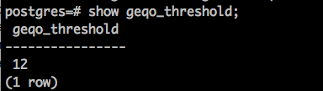
Postgres Planner/Optimizer
If the query uses less than geqo_threshold relations, a near-exhaustive search algorithm conducted to find the best join sequence. The default value is for this parameter in 12.
When geqo_threshold is exceeded, the join sequences considered are determined by heuristics search method– Genetic Algorithms (GA)
Notes:
This algorithm, first introduced in IBM's System R database, produces a near-optimal join order, but can take an enormous amount of time and memory space when the number of joins in the query grows large.
When geqo_threshold is exceeded, the join sequences considered are determined by heuristics search method– Genetic Algorithms (GA)
Implemented using the GEQO module in Postgres. The query optimization problem as though it were the well-known traveling salesman problem (TSP).

Slide 8
Cost estimation
How long will a query take?
CPU : small cost; tough to estimate
Disk : # of block transfers
Memory : amount of DRAM used
Network: # of messages
How many tables will be read/written?
What statistics to keep?

Slide 9
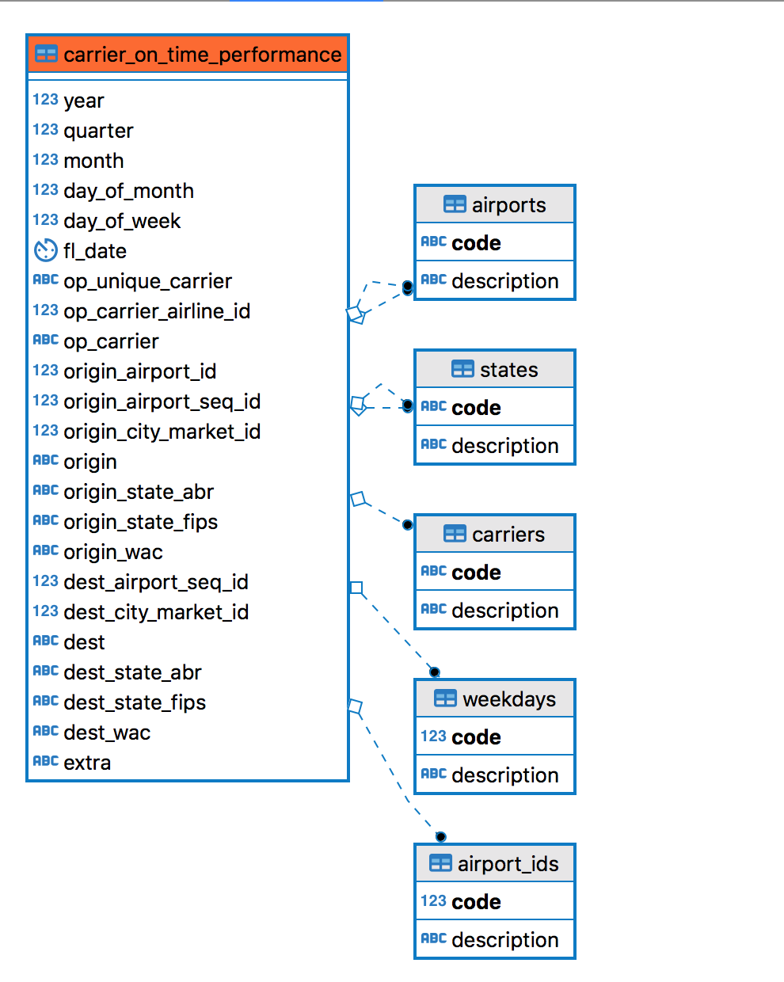
Sample database – transport stats airlines
Source: https://www.transtats.bts.gov/Tables.asp?DB_ID=120&DB_Name=Airline%20On-Time%20Performance%20Data&DB_Short_Name=On-Time
Notes:
Table shows:
on-time arrival and departure data for non-stop domestic flights by month and year, by marketing network, marketing carrier that reports and regional code-share group, by origin and destination airport.

Slide 10
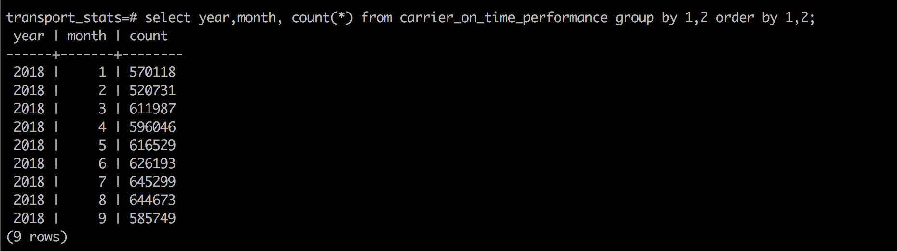
Sample database
transport_stats=# select count(*) from carrier_on_time_performance;
Count
---------
5417325

Slide 11
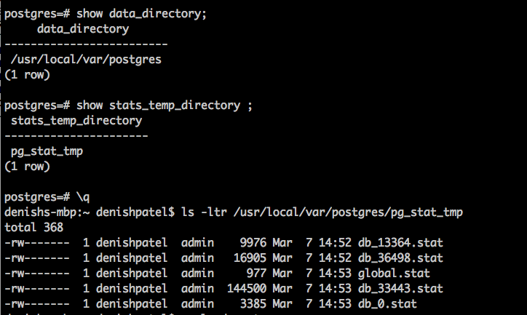
Statistics
Postgres stores internal statistics about tables, attributes and indices in internal catalog
ANALYZE
VACUUM ANALYZE
Auto-vacuum analyze

Slide 12
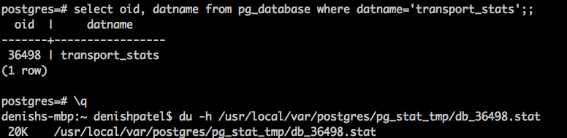
statistics

Slide 13
Postgres query plans
Each query requires a Plan
EXPLAIN is your friend!
EXPLAIN (ANALYZE, BUFFERS) SELECT * FROM X;
Using ANALYZE will actually execute the query. Don’t worry you can rollback
BEGIN;
EXPLAIN ANALYZE UPDATE tablename WHERE X=y;
ROLLBACK;

Slide 14
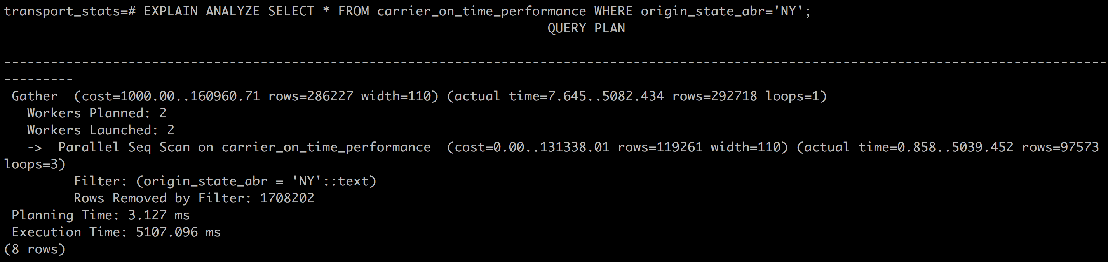
Explain ANALYZE

Slide 15
Explaining explain
Parallel Seq Scan on carrier_on_time_performance
(cost=0.00..131338.01 rows=119261 width=110) (actual time=0.858..5039.452 rows=97573 loops=3)
Cost of retrieving first row
Cost of retrieving all rows
Number of rows returned
Avg. width of rows (bytes)
Number of times executed

Slide 16
Explaining the explain
The costs are measured in arbitrary units determined by the planner's cost parameters
seq_page_cost - units of disk page fetches . Default is 1.0
Random_page_cost
cpu_tuple_cost (and others)
Upper-level node includes the cost of all its child nodes
Cost does not consider the time spent transmitting result
Planning time does not include parsing or rewriting.
Execution time - Time spent executing AFTER triggers is not counted
Notes:
The costs are measured in arbitrary units determined by the planner's cost parameters
seq_page_cost
units of disk page fetches . Default is 1.0
candom_page_cost
cpu_tuple_cost (and others)
It's important to understand that the cost of an upper-level node includes the cost of all its child nodes.
The cost only reflects things that the planner cares about. In particular, the cost does not consider the time spent transmitting result rows to the client, which could be an important factor in the real response time!
The Planning time shown by EXPLAIN ANALYZE is the time it took to generate the query plan from the parsed query and optimize it. It does not include parsing or rewriting.
The Execution time shown by EXPLAIN ANALYZE includes executor start-up and shut-down time, as well as the time to run any triggers that are fired, but it does not include parsing, rewriting, or planning time.
Time spent executing AFTER triggers is not counted there because AFTER triggers are fired after completion of the whole plan.

Slide 17
Explaining explain – limit?
transport_stats=# explain analyze select * from public.carrier_on_time_performance where origin='BWI' and origin_state_abr='MD' limit 1;
QUERY PLAN
-------------------------------------------------------------------------------------------------------------------------------------
Limit (cost=0.00..156.62 rows=1 width=110) (actual time=0.038..0.039 rows=1 loops=1)
-> Seq Scan on carrier_on_time_performance (cost=0.00..184345.88 rows=1177 width=110) (actual time=0.036..0.037 rows=1 loops=1)
Filter: ((origin = 'BWI'::text) AND (origin_state_abr = 'MD'::text))
Rows Removed by Filter: 59
Planning Time: 1.790 ms
Execution Time: 0.074 ms

Slide 18
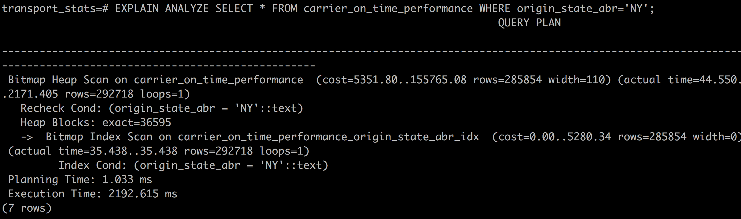
Let’s create index

Slide 19
scans
Sequential Scan
Bitmap Scan
Index Scan
What is Re-check condition?
Notes:
Sequential Scan
Scan through all records
Bitmap Scan
A bitmap scan fetches all the tuple-pointers from the index in one go, sorts them using an in-memory "bitmap" data structure, and then visits the table tuples in physical tuple-location order.
Index Scan
Index Scan node
Indexes generally have to be created
Often requires accessing index and heap
What is Re-check condition?
If the bitmap gets too large we convert it to "lossy" style, in which we only remember which pages contain matching tuples instead of remembering each tuple individually. When that happens, the table-visiting phase has to examine each tuple on the page and recheck the scan condition to see which tuples to return.

Slide 20
cardinality
Uniqueness of data values contained in a column
High - percentage of totally unique values
Low - repeat data
Index on low cardinality does not help
transport_stats=# select origin_state_abr,count(*) from carrier_on_time_performance group by 1 order by 2 desc limit 3;
origin_state_abr | count
------------------+--------
CA | 595402
TX | 565602
FL | 421752
(3 rows)
Notes:
Cardinality refers to the uniqueness of data values contained in a column.
HIGH cardinality means that the column contains a large percentage of totally unique values.
Low cardinality means that the column contains a lot of “repeats” in its data range.
Index on low cardinality does not help

Slide 21
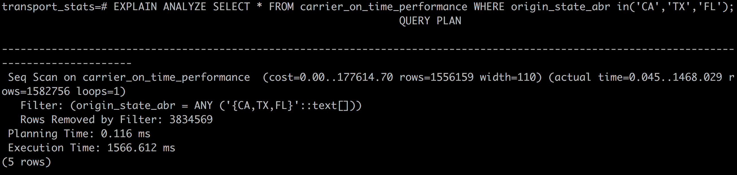
cardinality

Slide 22
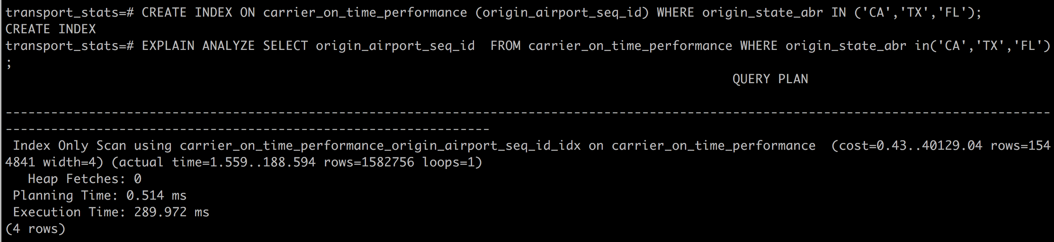
Partial index

Slide 23
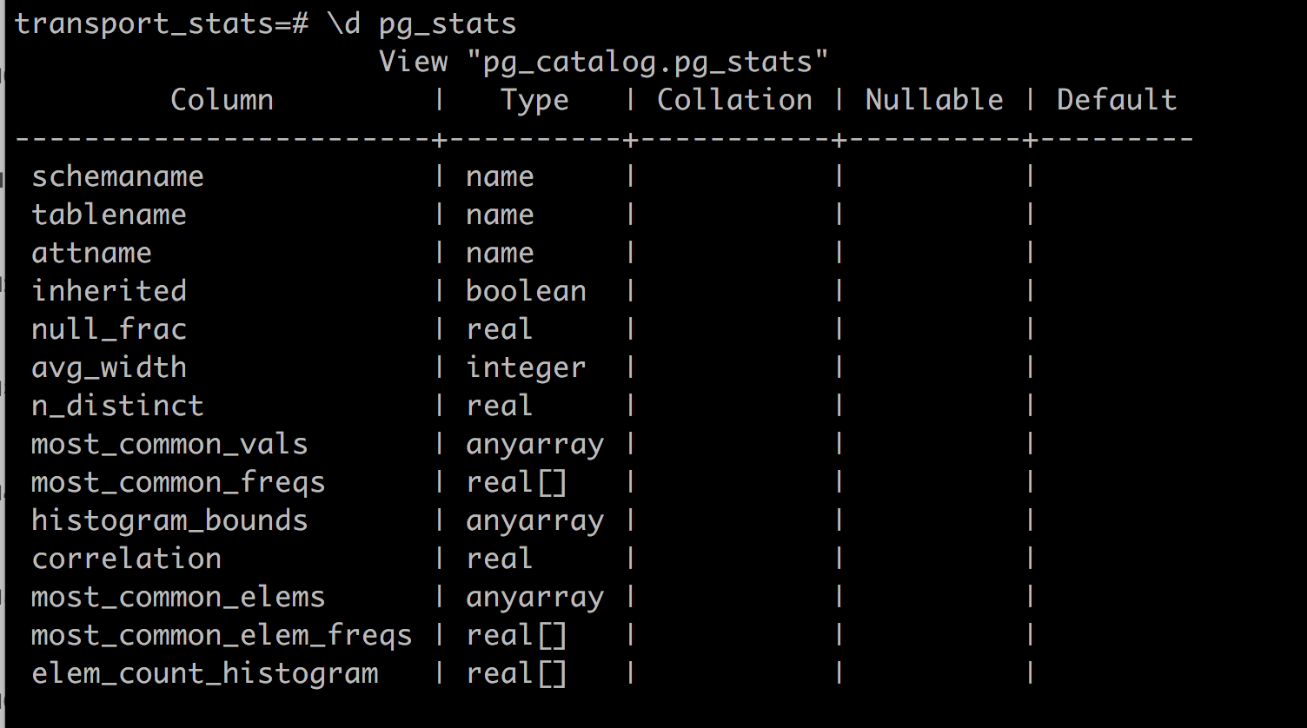
Row estimation
Postgres keep tracks of histogram values for row estimation in pg_statistics table
pg_stats view

Slide 24
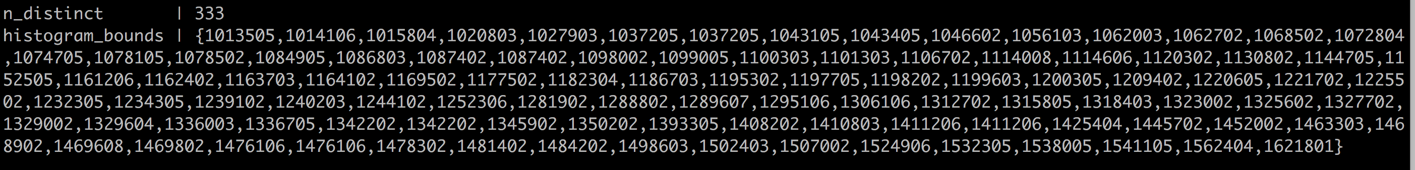
histograms
SELECT n_distinct, histogram_bounds FROM pg_stats WHERE tablename ='carrier_on_time_performance' AND attname='origin_airport_seq_id’;

Slide 25
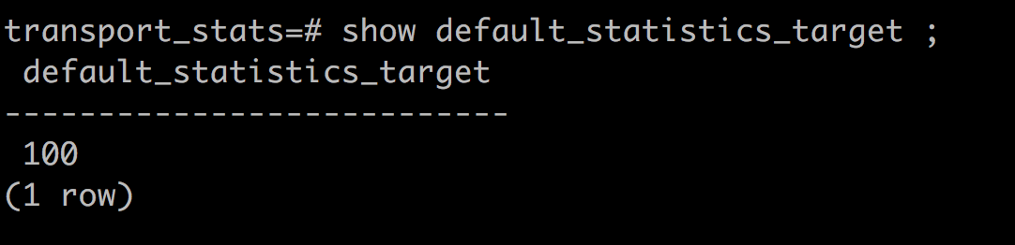
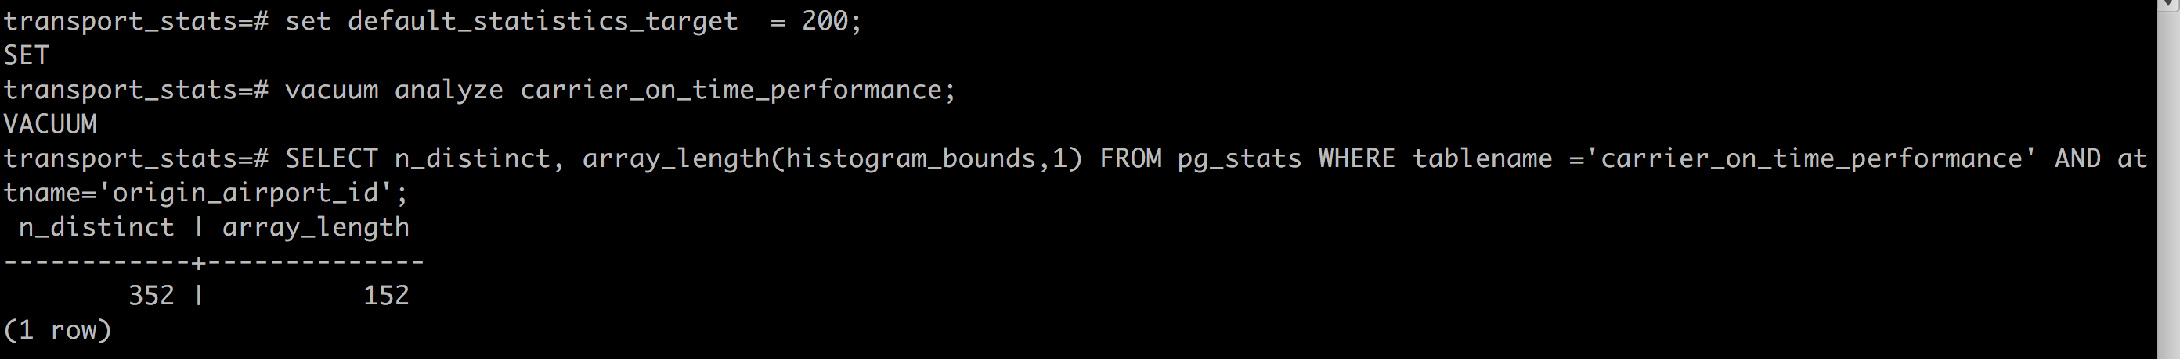
Default_statistics_target

Slide 26
Default_statistics_target
transport_stats=# alter table carrier_on_time_performance alter COLUMN origin_airport_id set statistics 1000;
ALTER TABLE
transport_stats=# alter table carrier_on_time_performance alter COLUMN origin_airport_id set statistics -1;
ALTER TABLE

Slide 27
Let’s talk about join
Nested Loop
Hash Join
Merge Join

Slide 28
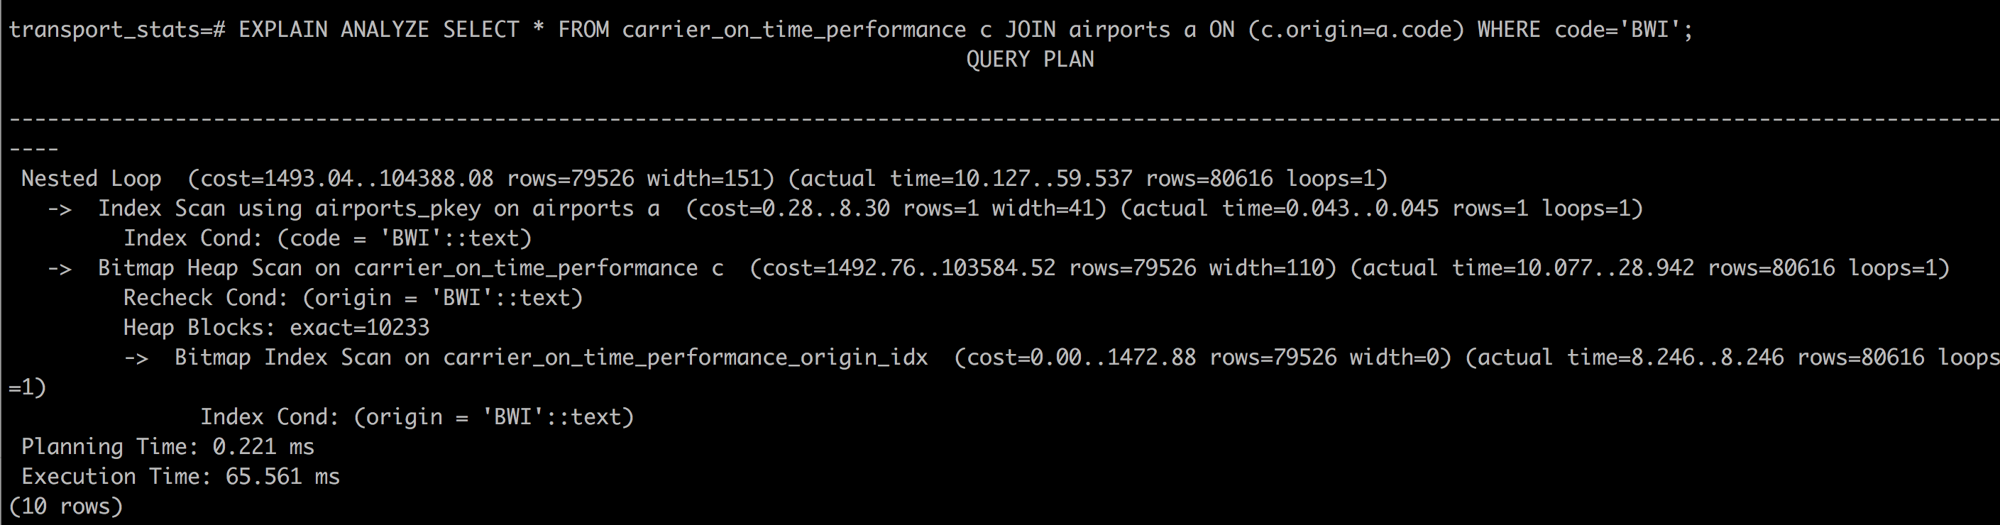
Nested loop

Slide 29
Netsted loop
Iterate all entries form “airports” and find relevant entries from “carrier_on_time_performance” table
Emitting rows with WHERE clause (WHERE airport code='BWI’)
Slower in performance (if index is not used)
Make sure relevant index exist to match WHERE clause
A nested loop is the only join algorithm Postgres has that can be used to process any join!

Slide 30
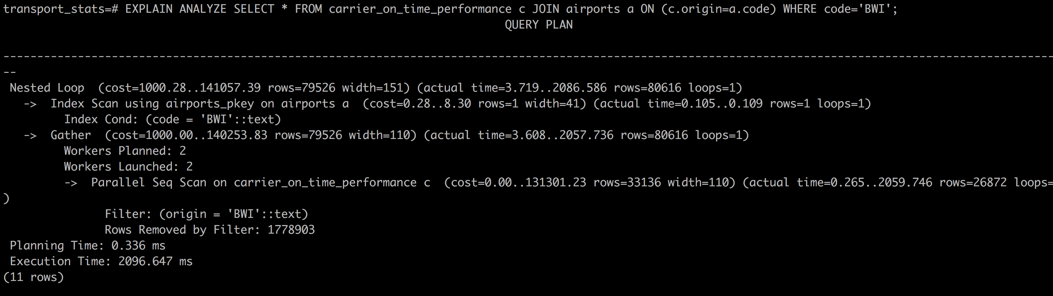
Netsted loop – no index

Slide 31
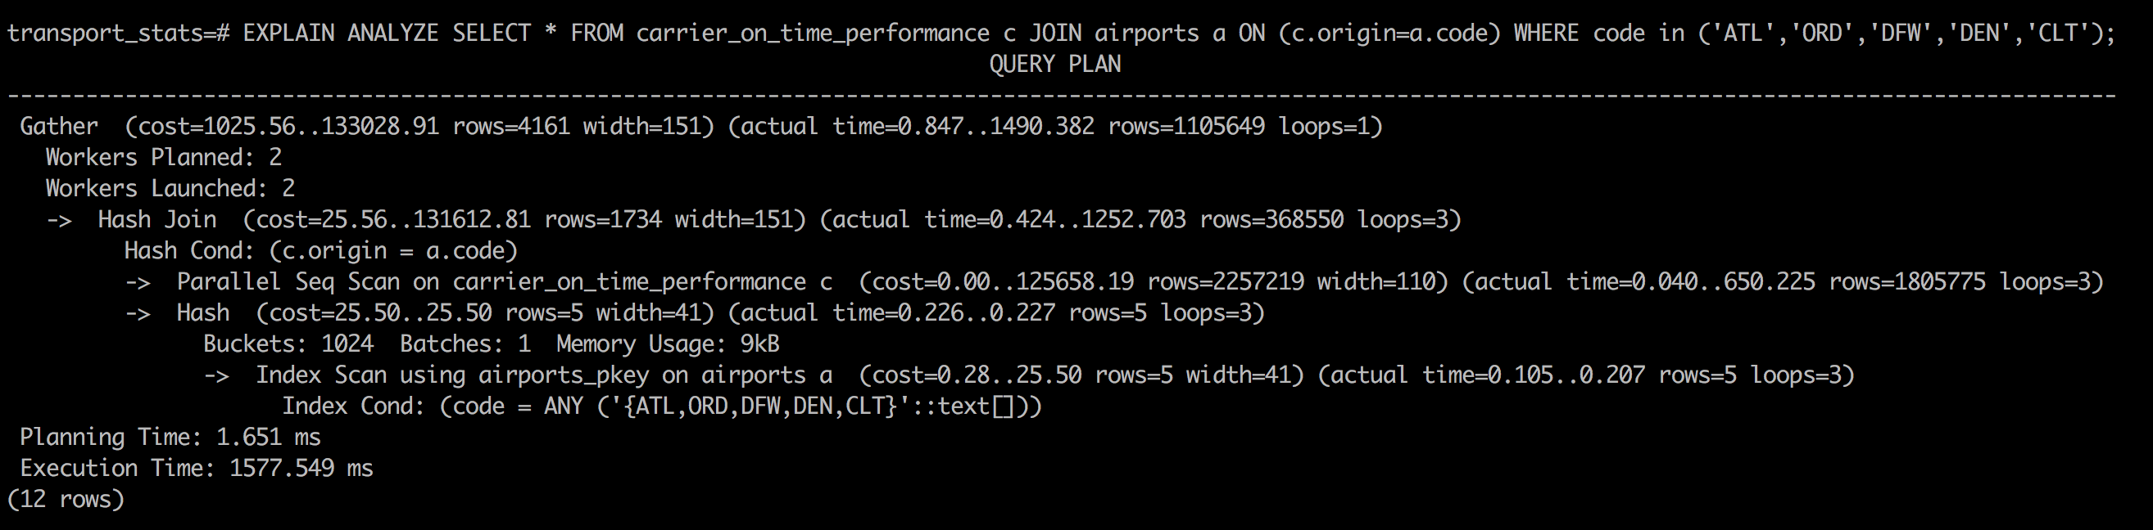
Hash join

Slide 32
Hash join
Create a small hash table from large table
The resulting hash table has to fit in memory
If the table is really small, a nested loop is used
Different index strategy:
Hash joins do not need indexes on the join predicates. They use the hash table instead.
A hash join uses indexes only if the index supports the independent (any column but join column) predicates
Reduce the hash table size to improve performance
Horizontally (less rows)
Vertically (less columns) – avoid SELECT * FROM table
Hash joins cannot perform joins that have range conditions in the join predicates
Notes:
Create a small hash table from large table
The resulting hash table has to fit in memory
If the table is really small, a nested loop is used because of the complexity of creating a hash table
Different index strategy:
Hash joins do not need indexes on the join predicates. They use the hash table instead.
A hash join uses indexes only if the index supports the independent (any column but join column) predicates
Reduce the hash table size to improve performance
Horizontally (less rows)
Vertically (less columns) – avoid SELECT * FROM table
Hash joins cannot perform joins that have range conditions in the join predicates

Slide 33
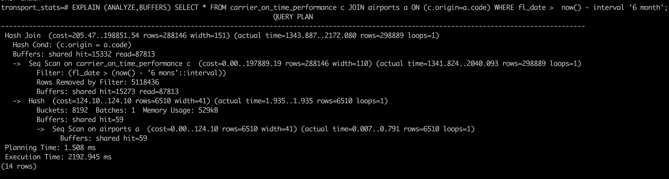
Hash join

Slide 34
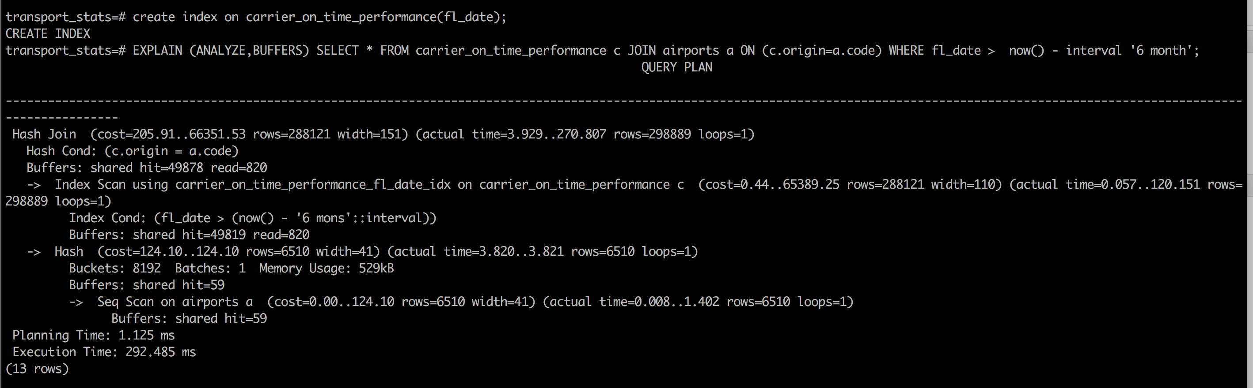
Hash join

Slide 35
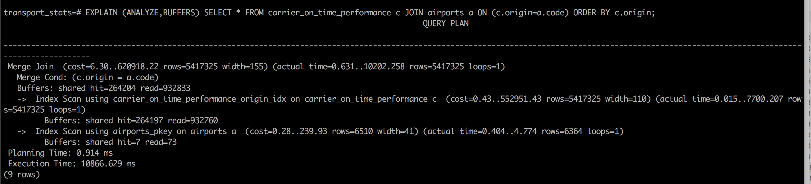
Merge join

Slide 36
Merge join
The MERGE join combines two sorted lists.
Both sides of the join must be sorted by the JOIN PREDICATES.
Similar index strategy like HASH JOIN
Make sure the index is sorted list

Slide 37
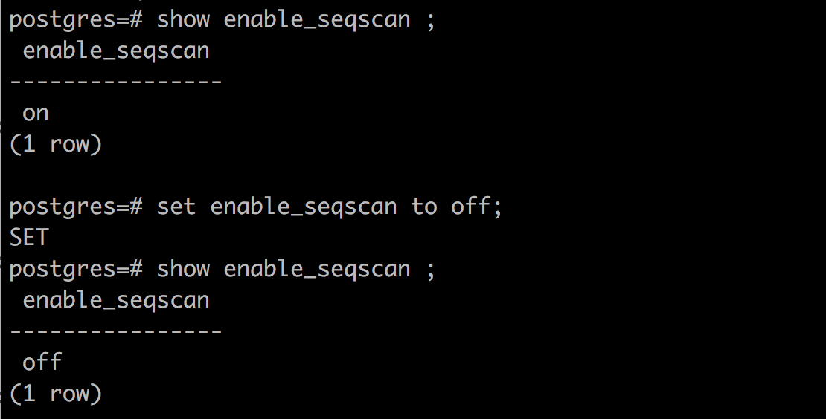
Hints? - PostgreSQL conf parameters
#enable_bitmapscan = on
#enable_hashagg = on
#enable_hashjoin = on
#enable_indexscan = on
#enable_indexonlyscan = on
#enable_material = on
#enable_mergejoin = on
#enable_nestloop = on
#enable_parallel_append = on
#enable_seqscan = on
#enable_sort = on

Slide 38
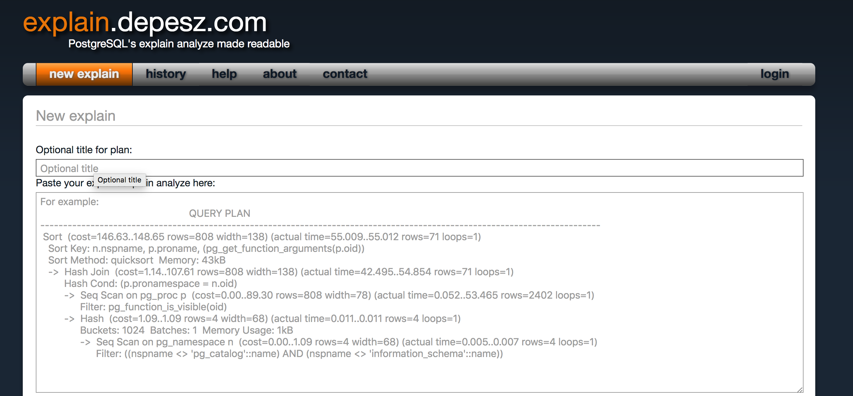
https://explain.depesz.com/
https://explain.depesz.com/

Slide 39
Let’s practice
Find top 5 best performant carriers departing from BWI airport
Find top 5 best performance carries arriving to BWI

Slide 40
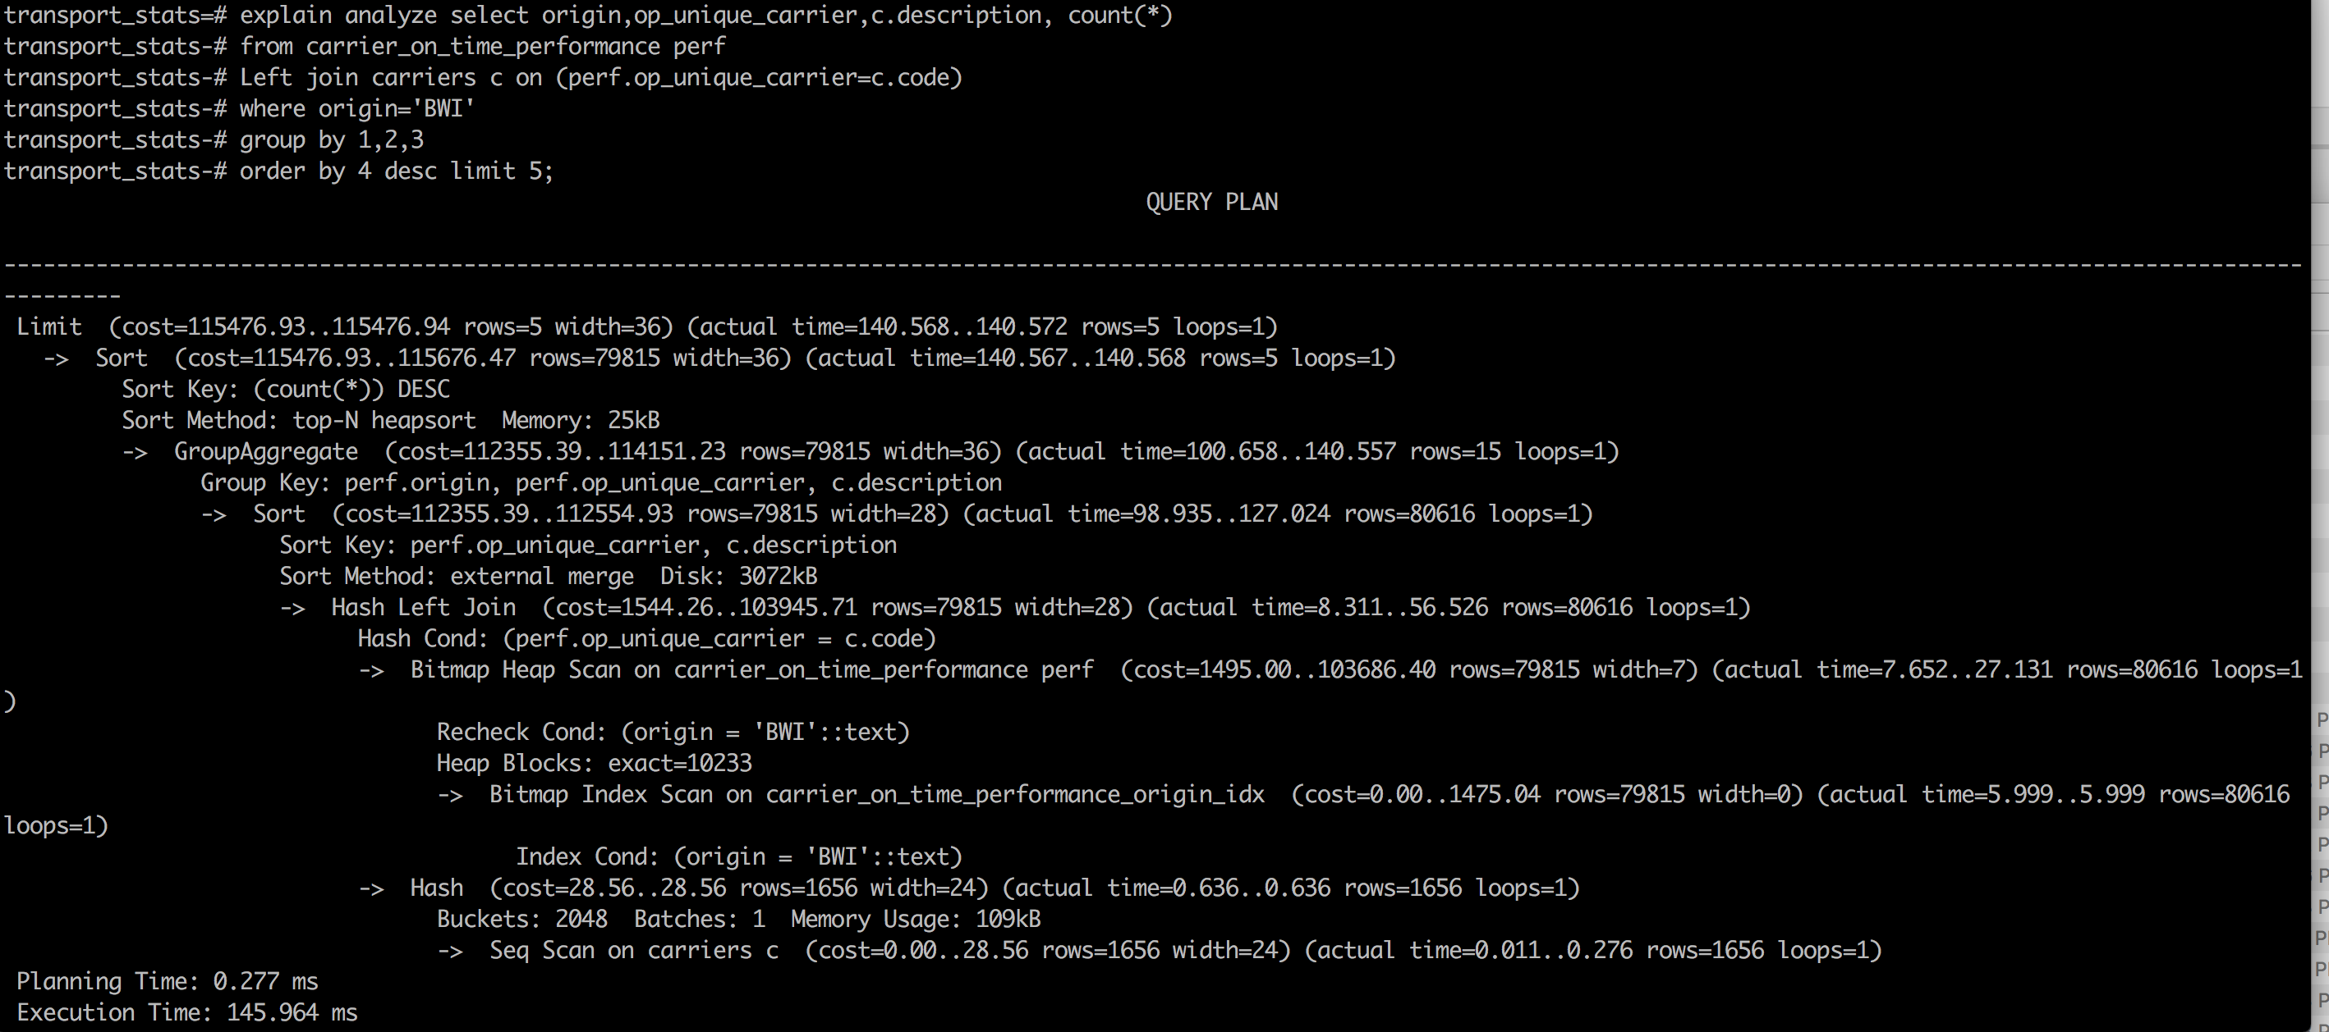
Departing from bwi

Slide 41
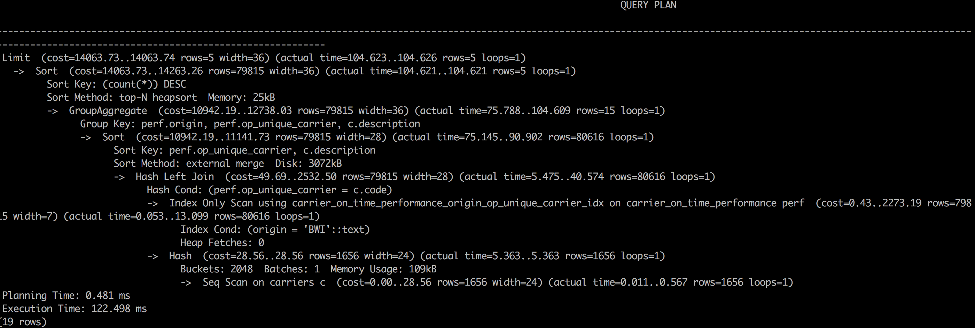
Query stats after adding index
transport_stats=# create index on carrier_on_time_performance(origin,op_unique_carrier);
CREATE INDEX

Slide 42
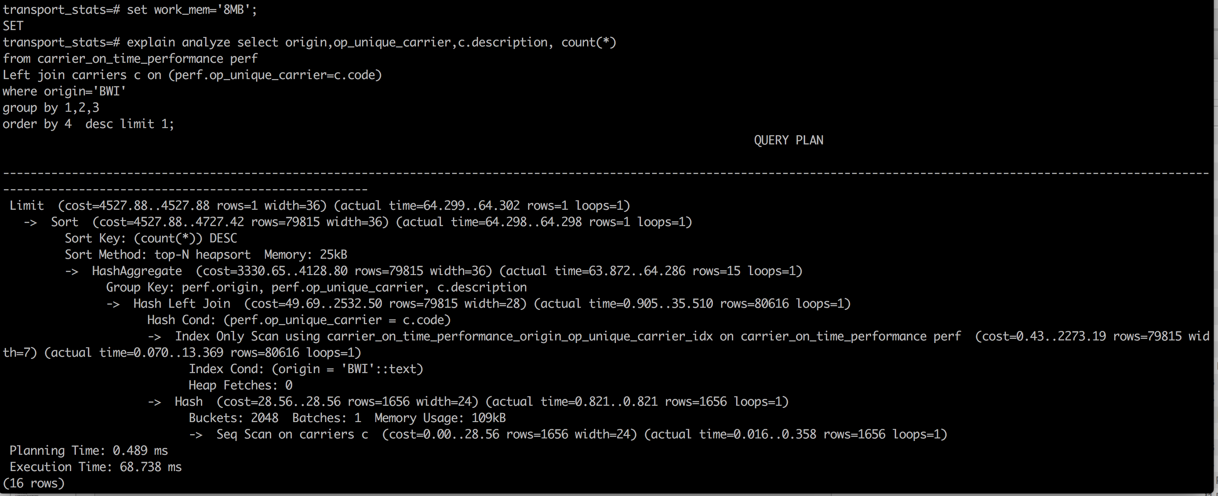
Remove Disk sort?

Slide 43
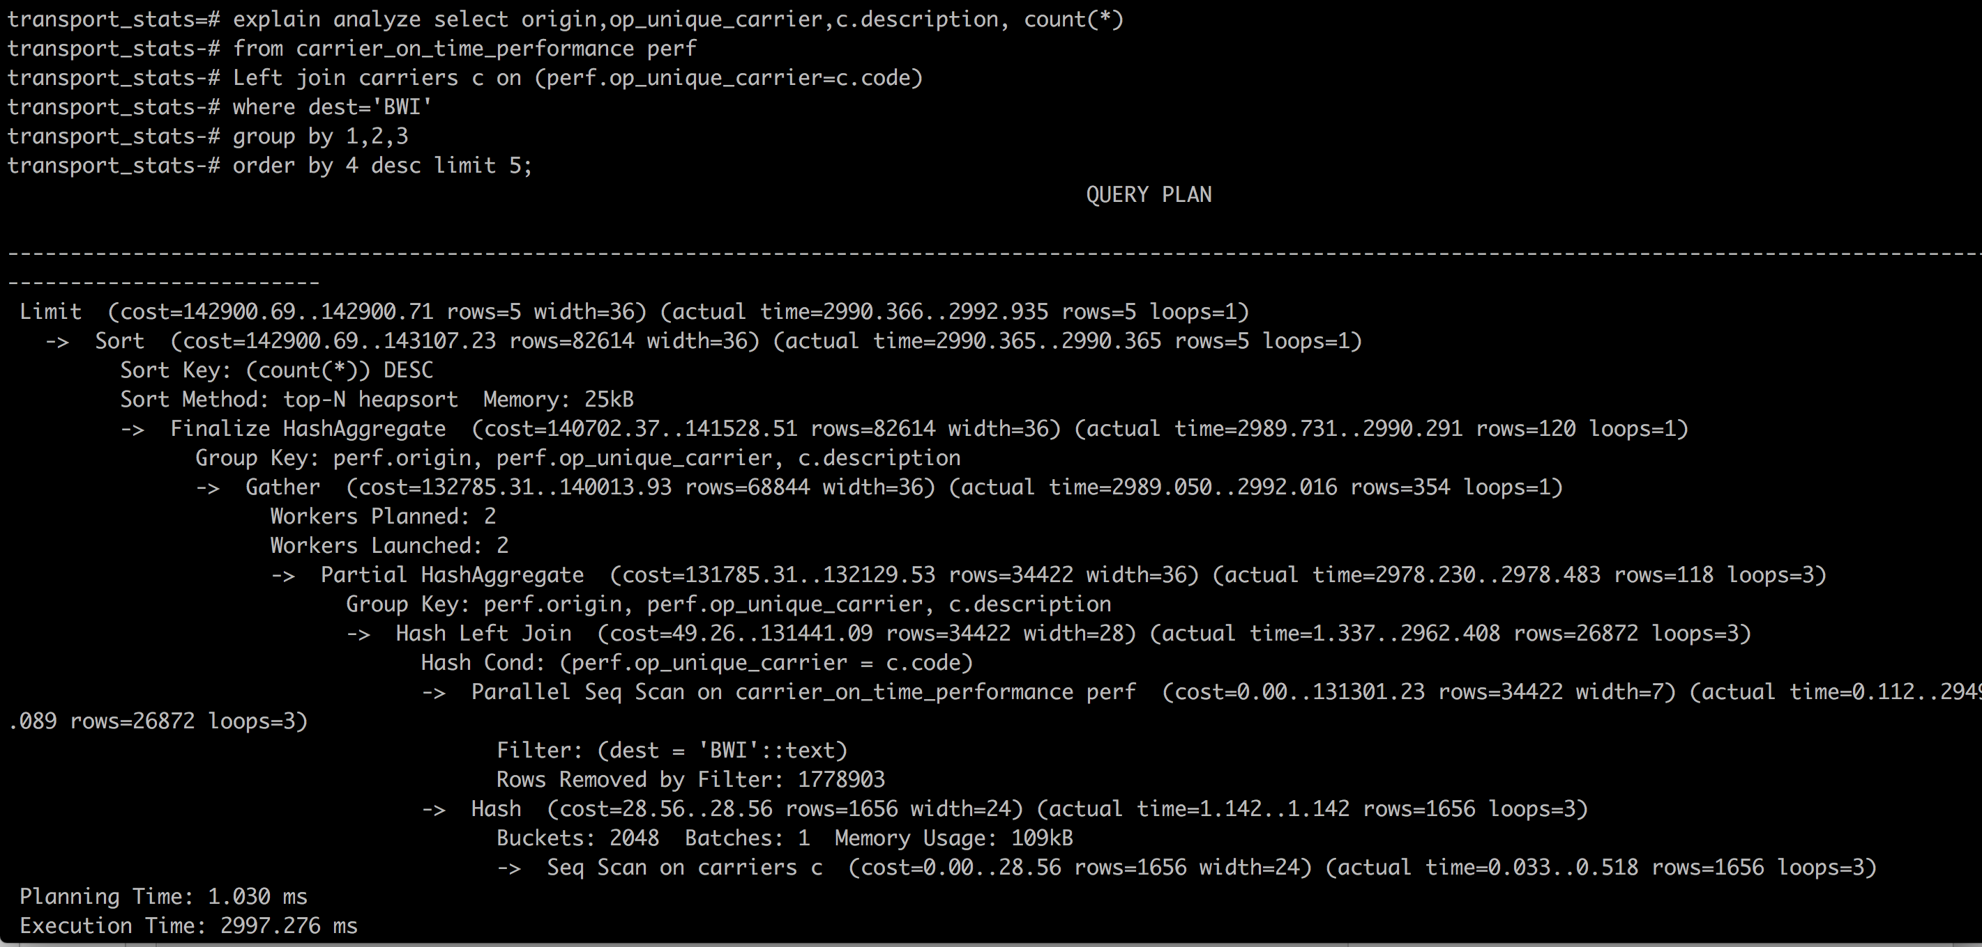
Find top 5 best performance carries arriving to BWI

Slide 44
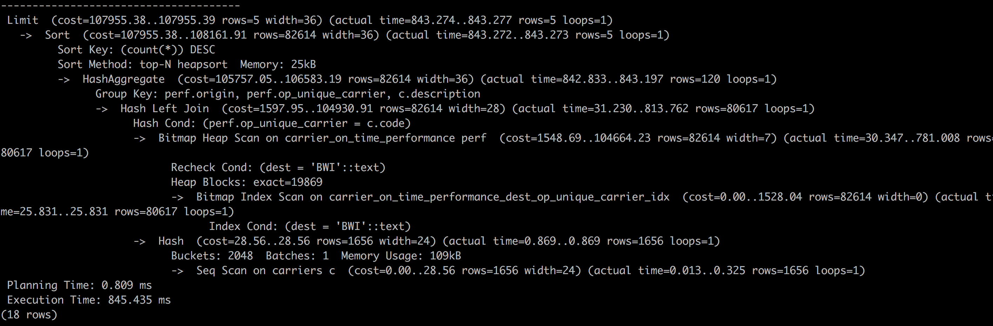
Add index
transport_stats=# create index on carrier_on_time_performance(dest,op_unique_carrier);

Slide 45
results
transport_stats=# select origin,op_unique_carrier,c.description, count(*)
from carrier_on_time_performance perf
Left join carriers c on (perf.op_unique_carrier=c.code)
where dest='BWI'
group by 1,2,3
order by 4 desc limit 5;
origin | op_unique_carrier | description | count
--------+-------------------+------------------------+-------
ATL | DL | Delta Air Lines Inc. | 2885
MCO | WN | Southwest Airlines Co. | 2522
FLL | WN | Southwest Airlines Co. | 2494
BOS | WN | Southwest Airlines Co. | 2457
TPA | WN | Southwest Airlines Co. | 1998
(5 rows)

Slide 46
Take away …
Keep the statistics updated
Keep auto-vacuum turned ON
Identify slow query postgres logs or pg_stat_statements
EXPLAIN ANALYZE
Review cardinality , histograms
Try out different indices based on JOIN conditions
B-tree
Partial index
Functional index

Slide 47
Take Away ..
If possible, try to avoid selecting all columns
If query is not using index
default_statistics_target
Play with different session level settings to understand optimizer behavior
i.e set enable_seqscan on;

Slide 48
Thank You!
Thanks for attending!
Looking forward to chat over Slack channel !
https://postgres-slack.herokuapp.com/

Slide 49
Questions?
Any question?
Future questions:
Denish.j.patel@gmail.com
Slack channel

